Slide 1
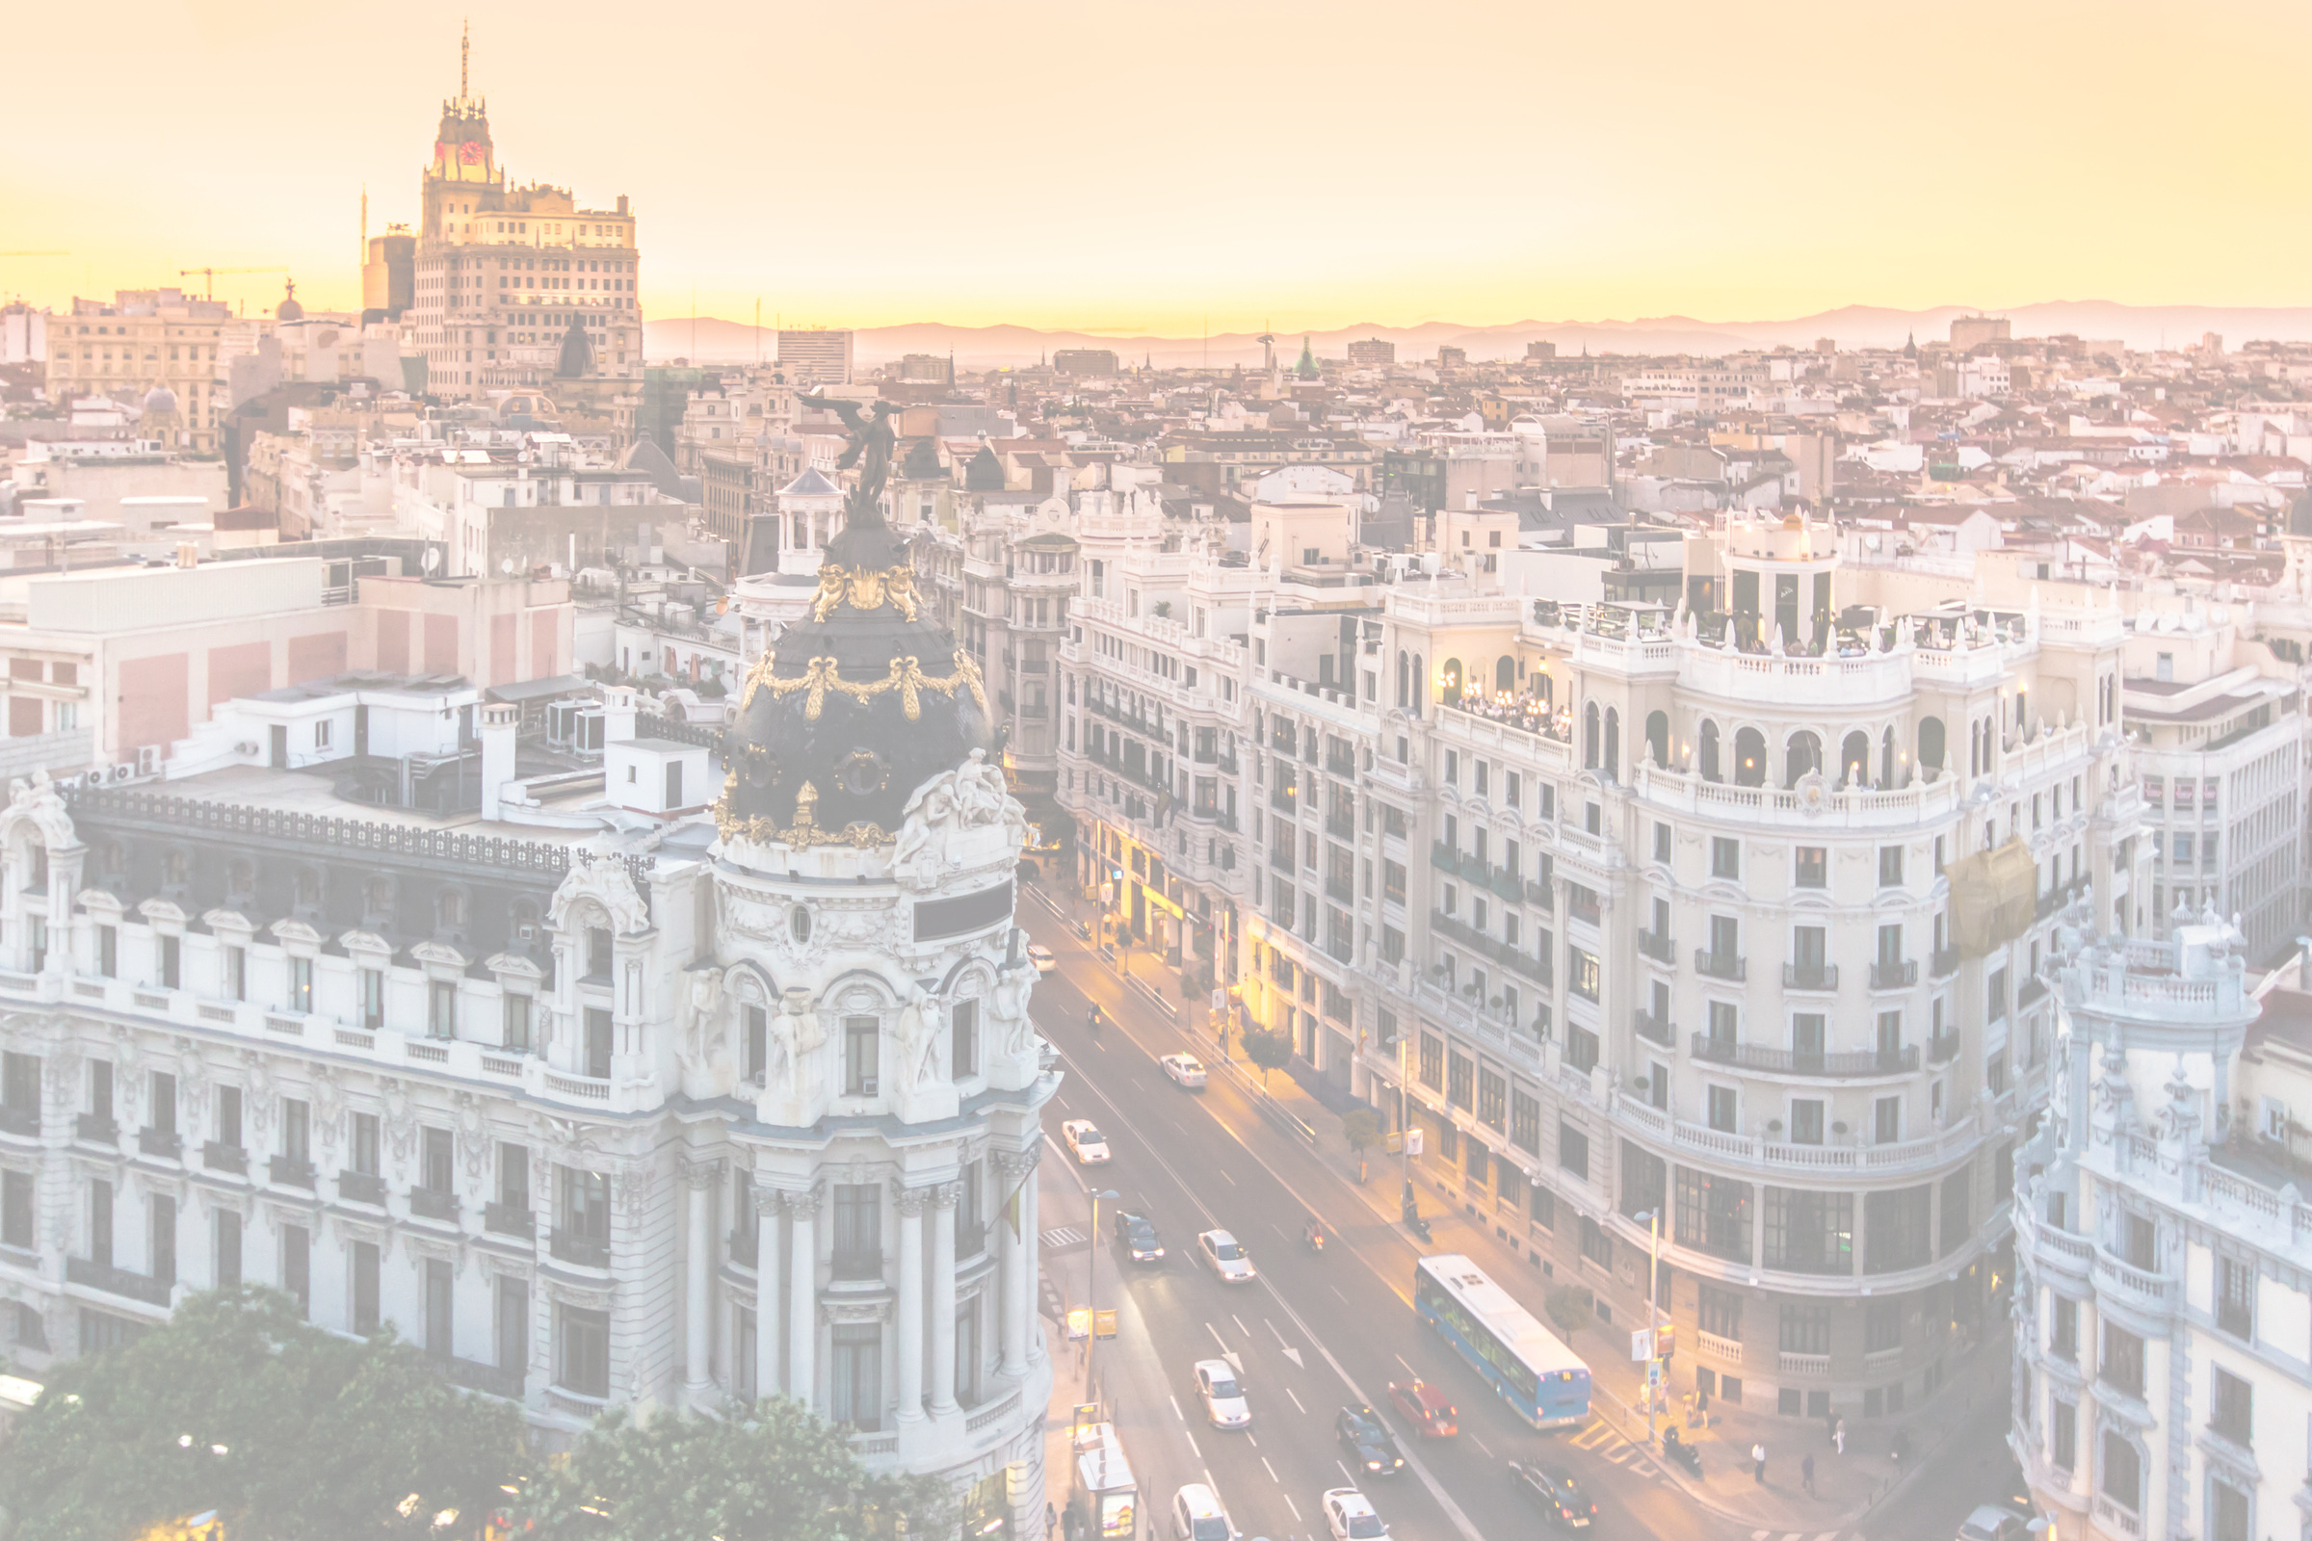

A walking tour of Madrid
Contexts4Content

Slide 2


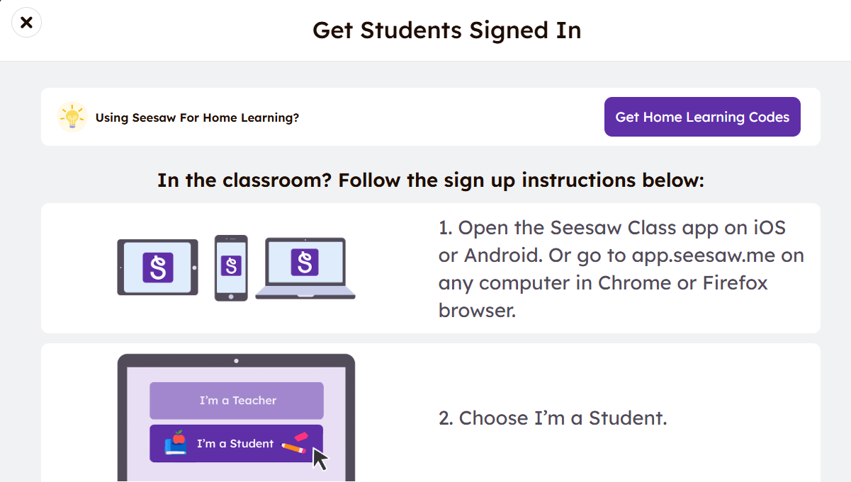
Seesaw
• Go to your app store and download the Seesaw Learning App

Slide 3
GROUPS
Parque del Retiro | Jardines de Sabatini
Claudia Zelaschi Mara Galasso Julia Costigan-von Blohn Luis Filipe Gama Melo | Maria Grazia Giribaldi Silvia Dello Joio Carsten Gottlieb Mónica Cristina Correia Vieira

Slide 4
There are 2 groups
Follow your tutor´s instructions for the tour and the tasks provided.
Please stay with your group!
Share your place photos on SeeSaw if you can.
The activity lasts 90 minutes but you are free to stop for a break. The activity ends when you want it to end.

Slide 5
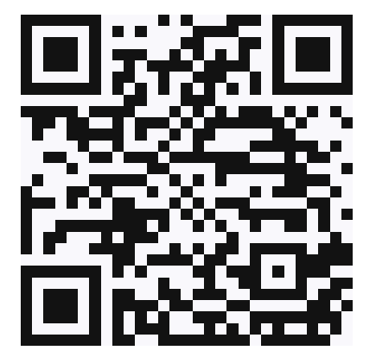
GROUP 1
Starting point: Plaza Mayor

Slide 6
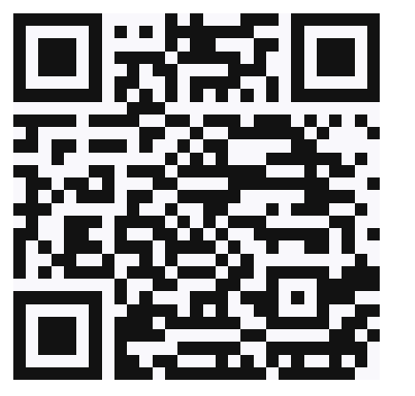
GROUP 2
Starting point: Plaza Mayor

Slide 7
